Slide 1

Community detection in VK
Internship project report
Fulfilled by:
Nikitin Bogdan
DSBA 181-1
Summer 2019

Slide 2



For a given VK community, it is necessary to detect sub-communities inside, investigate them and ﬁnd dependencies
Obtain data from community and create a graph
Implement Karger’s algorithm and compare it with other algorithms for ﬁnding communities
Detect new dependencies in sub-communities
Technologies used: Python, C++; VK API; Pandas, NetworkX, Gephi

Slide 3
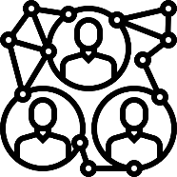
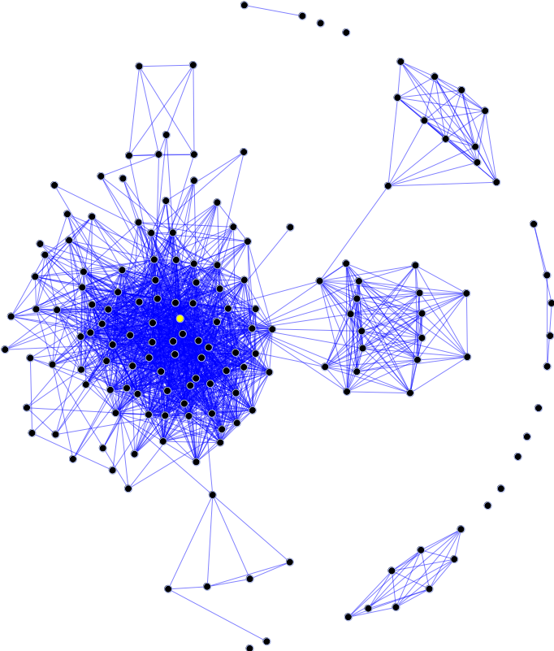
Theoretical problems
The definition is not universally accepted
Communities are sets of points which are ‘‘close’’ to each other, with respect to a measure of distance or similarity, defined for each pair of points
The concept is not rigorously defined, and require some degree of arbitrariness and/or common sense

Slide 4

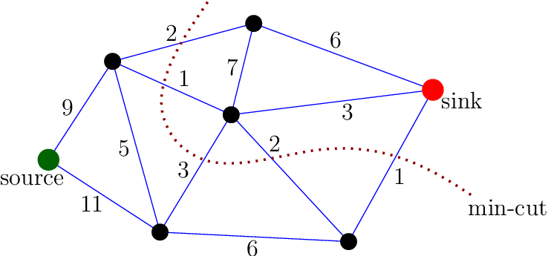
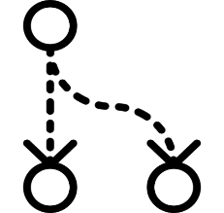
Graph partitioning
The problem of graph partitioning consists of dividing the vertices in g groups, such that the number of edges lying between the groups is minimal
The minimum cut between any two vertices s and t of a graph is any minimal subset of edges whose deletion would topologically separate s from t

Slide 5
Karger’s algorithm
a
d
a
Pick random edge, remove it and fuse it’s two nods into one
b
c
b
cd
Repeat until there is only one edge left
The edge will be a part of the minimum cut
ab
cd

Slide 6
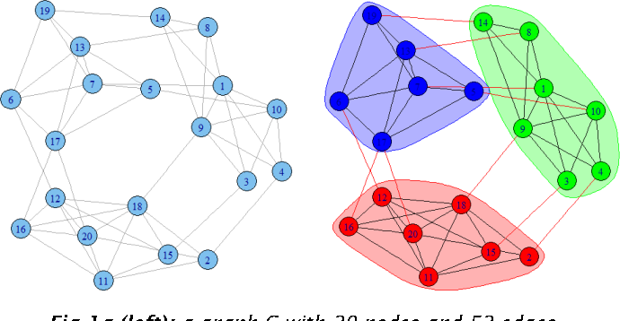
K-clique algorithm
Clique in an undirected graph is a subgraph that is complete. If there is a subset of k vertices that are connected to each other, we say that graph contains a k-clique

Slide 7
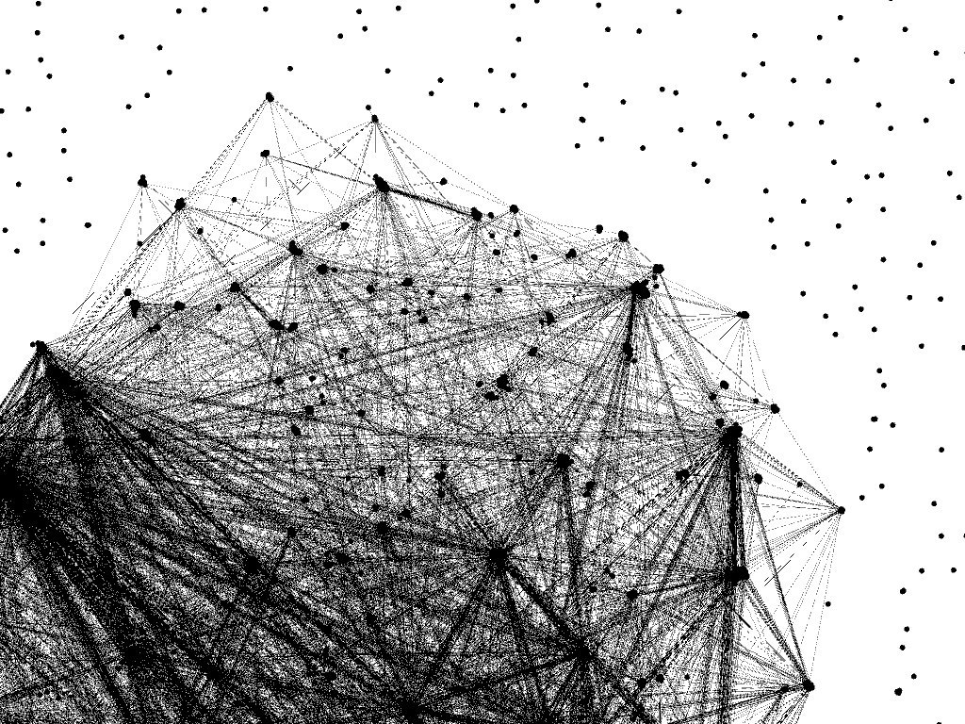
Big Data
Sub-groups of friends in a community with over 5000 subscribers

Slide 8
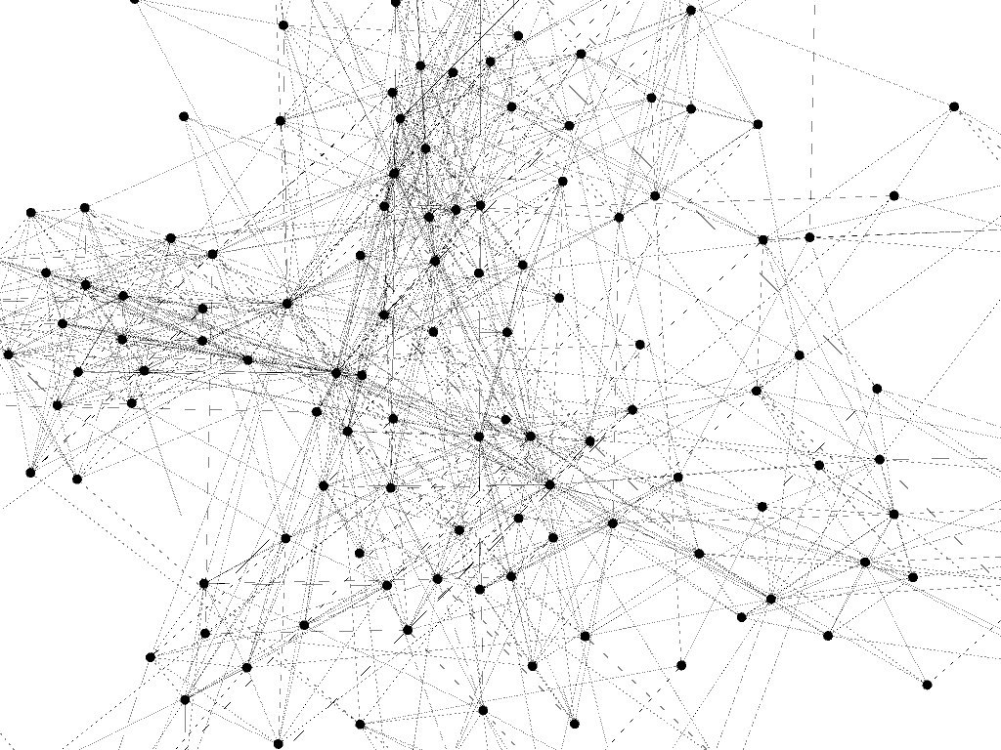
Community structure

Slide 9
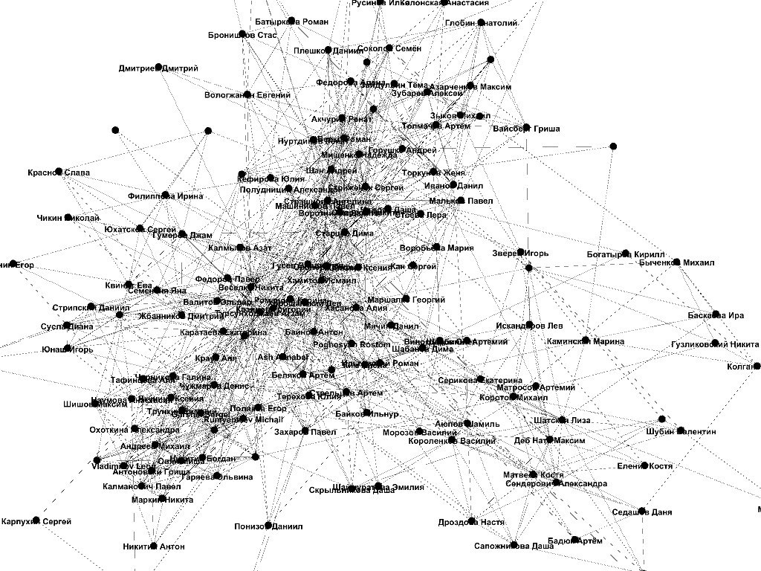
Nodes with labels

Slide 10
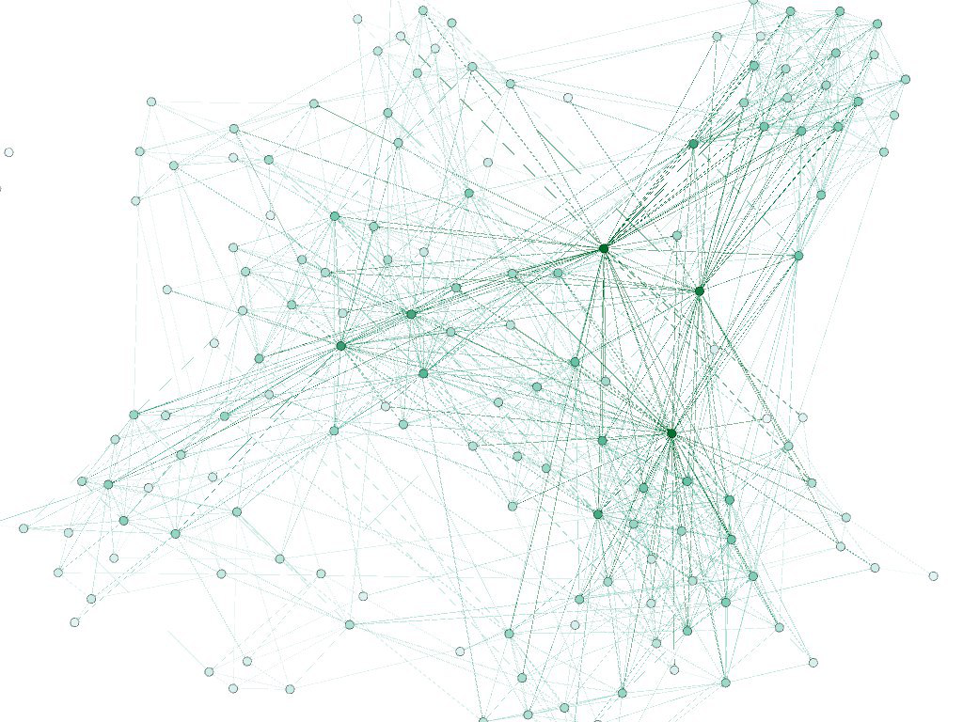
Network with degree ranking

Slide 11
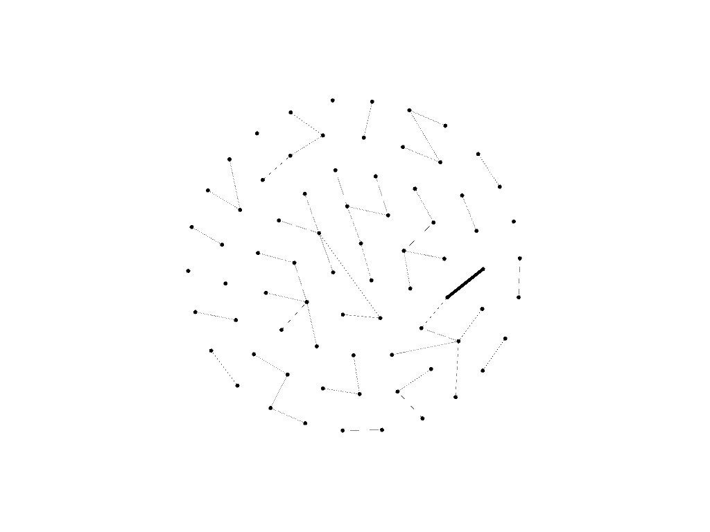
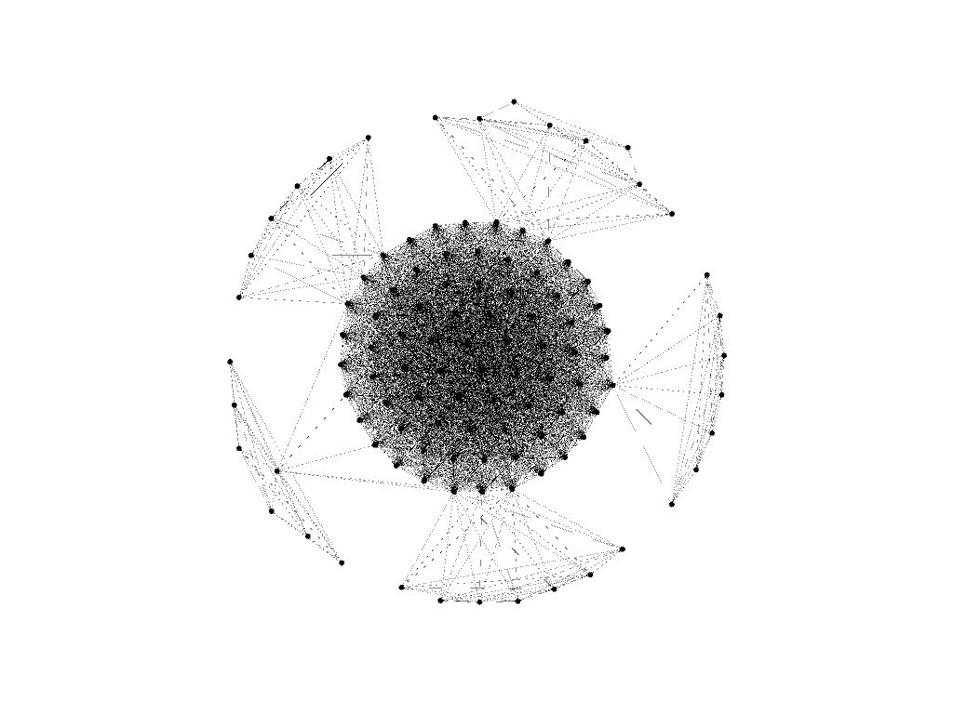
Karger’s algorithm
K-clique algorithm

Slide 12
Let’s discuss!

Slide 13
Contents
Introduction
Theoretical problems
Graph partitioning
Karger’s algorithm
K-clique algorithm
Big data
Community structure
Nodes with labels
Network with degree ranking
Results (Karger’s algorithm and K-clique algorithm)
Discussion

